Slide 1

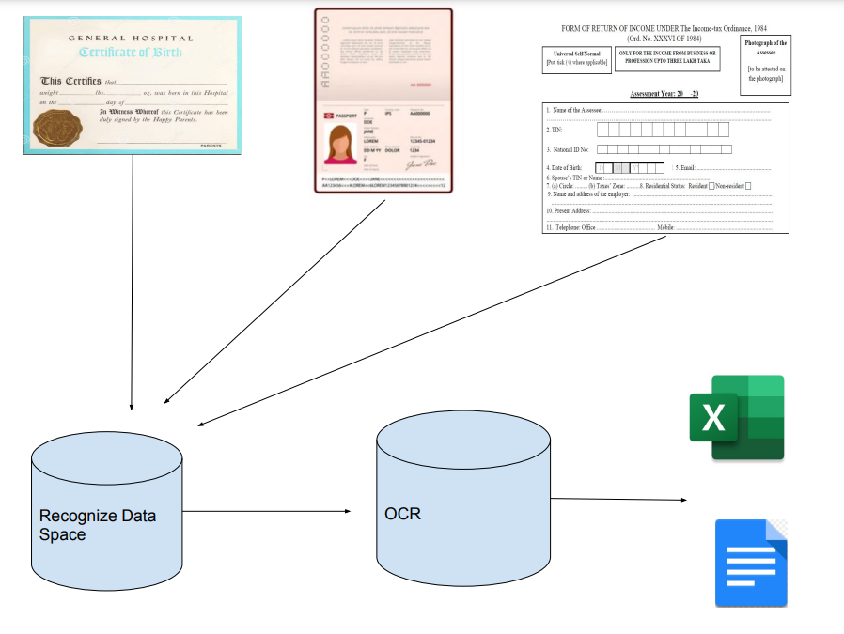
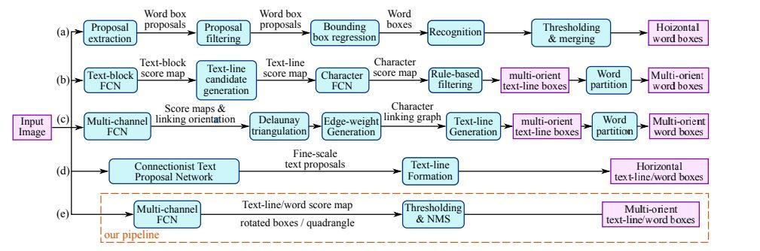
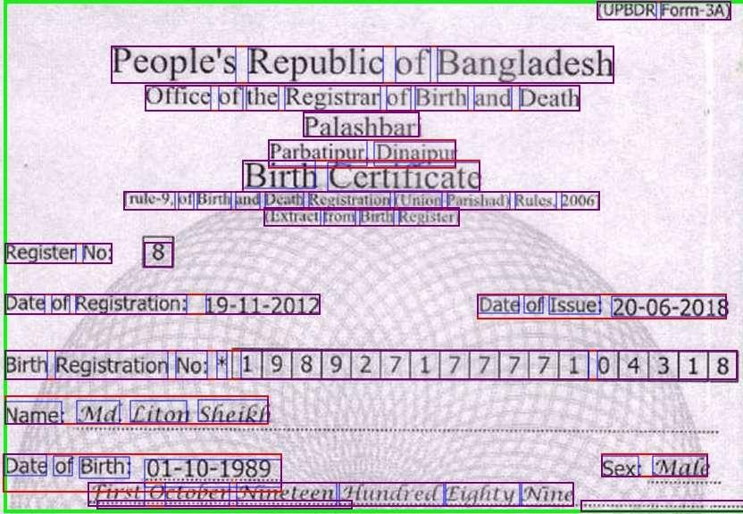
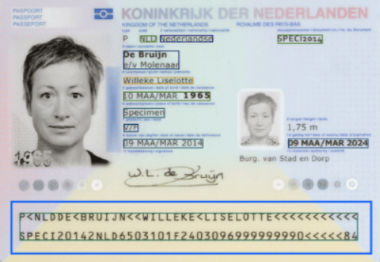
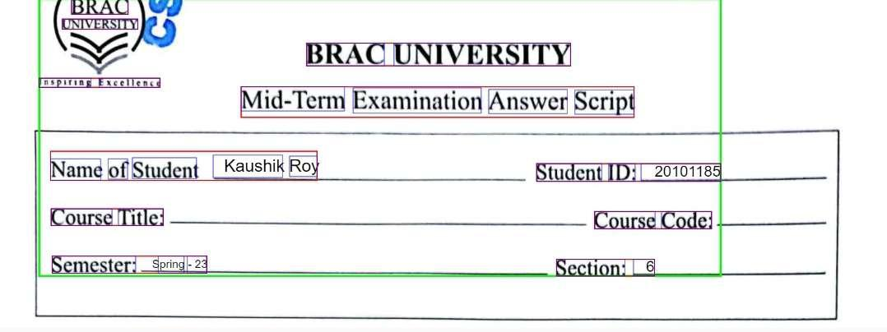
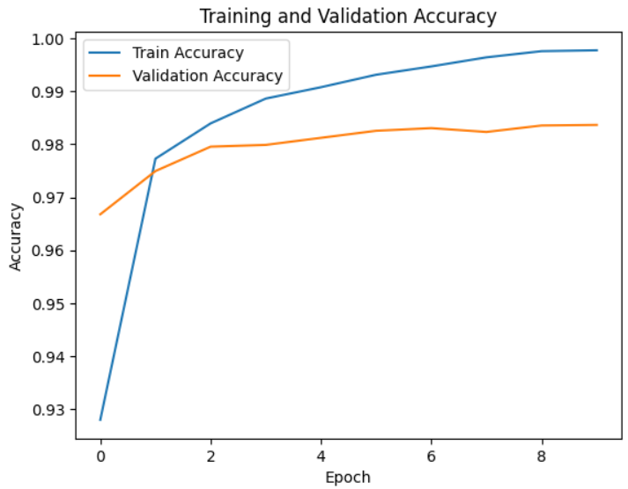
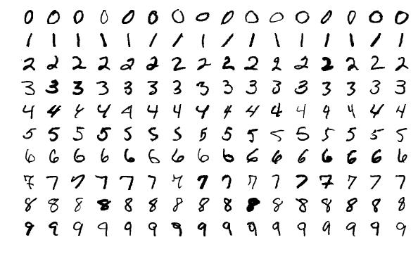
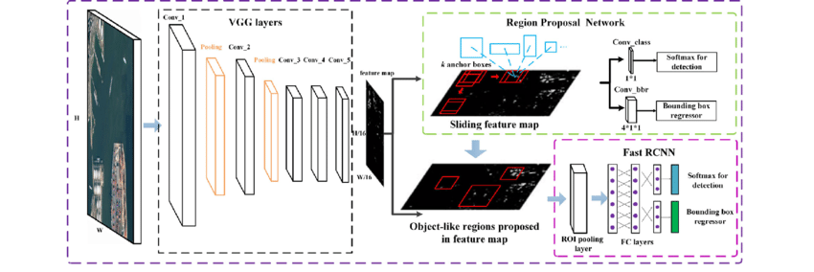
Document Text and Template Identification, Data Extraction Using Machine Learning And OCR On Android Environment
Md Fuad Islam, Md Minhazul Islam Rimon, Kaushik Roy, Tasnim Mobarak, Mysha Samiha Priota
Supervisor: Dr. Md. Khalilur Rahman
MD
Abstract
Model Overview
Literature Review
At present, when we want to send different kinds of documents for official reasons, we have to scan and send them. Then when the officials receive it, they have to manually process and identify the data and put it in the system. We wish to automate this part of the process for better efficiency and remove the scope of error. As most people have access to a smartphone, we want to apply a machine learning model in an android environment so that it can identify the text boxes and extract the data from it. For this, we want to apply OCR and integrate it in android system so the mass population can get access to it.
EAST stands for Efficient and Accurate Scene Text Detection. It is a deep learning model, used to extract text from a scene or image. EAST uses a single neural network and outputs the results as a text with a quadrilateral shape. It combines a convolutional network and non-max suppression (NMS). Convolutional networks are used to identify words in images, and NMS is used to combine all of the identified text or boxes into a single, substantial text or box. The neural network has been trained to predict the text and its geometry in the landscape. The method was developed for text detection and it produces detailed per-pixel text prediction.
Shubham et al. [7] used CNN (convolutional neural network) model for recognizing handwritten texts. They used the MNIST dataset for both training and testing purposes. In their approach, they first pre-processed the data via normalization, rotating and reversing, input image filtering. With data processed and fit for training, they used the SEQUENTIAL model which consisted of 8 linear stacks of layers. Lastly, they used various optimizers available for keras to train their model. After experimenting with all the models,they found out Adamax, a first order gradient-based optimization method provided the most accurate results.Also they used 2 convolutional layers for maximizing accuracy. With Adamax, the trained model had an accuracy of 87,1 percent. Though other optimizers like Adadelta, Adam, SGD provided close enough accuracy, Adamax reduced the training time significantly. With better data pre-processing methodology the accuracy, efficiency of this model can be improved and for our work using a 2 convolutional layers model with Adamax optimizer provided by keras is a viable option.
Zhengchao et al.[8] combined CNN and RNN to recognize scene text. CNN was used to extract features from an input image. Different descriptors like VGG16, VGG19, ResNet34, ResNet50 were used for feature extraction. Now extracted data was sequential feature map and CNN has a disadvantage in such cases. This is where RNN which can extract sequential objects of arbitrary lengths comes in. After experimenting with different neural networks they managed to combine advantages of both CNN and RNN and claimed that a deeper CNN with deep descriptor will be more effective in predicting scene texts.
Figure 1: General Process of the Application.
Introduction
Figure 4: Comparison of scene text detection algorithms from different recent studies.
(a) Pipeline for horizontal word detection and recognition proposed by Jaderberg et al. [1];
(b) Pipeline for multi-orient text detection proposed by Zhang et al. [2];
(c) Pipeline for multi-orient text detection proposed by Yao et al. [3];
(d) Method of Horizontal text detection using CTPN, proposed by Tian et al. [4];
(e) Pipeline proposed by Zhou et al. [5] (EAST Model) which, according to the authors, is simpler and has two phases, eliminating the majority of intermediate procedures of the earlier systems.
Result
In our daily life, we go through and process an impressive amount of documents. Documents like birth certificates, income tax, different types of government forms, passports, exam papers etc. Almost in all cases, we are required to extract data from these documents and copy them to a different virtual storage. These processes are tedious and time consuming. And in more than enough cases, there are bound to be some mistakes made which makes them even more obscure. That's why are developing a system that will automate these processes and make these tasks more efficient. The first obstacle that we need to overcome is identifying the texts in the document. With images containing various backgrounds we have to find the text data and put bounding box around it to extract the data. We have to achieve this while in the android environment. Then we will use OCR to extract the text and hand over the data to user for storing and using.
We used RCNN to recognize the text area and digitize the text. However, though the region proposal has been effective in object detention, it was a different story when we used the same principle to detect text boundaries. Thus we shifted to using the EAST model for detecting text boundaries and CNN to recognize the text. Currently, our model is able to recognize a single individual digit at a time. However, in real world scenarios there will be inputs of variable length and the model has to have the ability to string them together. As we previously mentioned, EAST can be used for detecting text boundaries and for this reason to solve our issue, we can modify the EAST model to detect not the entire string of text but individual letters. In addition to that, we can use another approach where we use LSTM to process variable length strings. Another issue we faced during our model creation is that while the accuracy of prediction for the data that are similar to the dataset used for training is considerably high, in real world implementation the accuracy took a huge backlash. This is mainly due to the quality of image being lower compared to the training dataset. There is more noise in the image, and pictures tend to get blurred as they are zoomed in on the digits. We are thinking of implementing better preprocessing methods that will improve the input data quality, ultimately increasing accuracy of the models prediction. Lastly, there is the part of implementing our trained model in an android environment. We were able to successfully convert the model into a version that is supported in the android. However, there were some issues regarding the model being successfully adapted into the system. We are planning to utilize other inference for the model in the future.
The fundamental element of this suggested method is the neural network model. When creating a neural network, there are a lot of considerations to make. The size of the images and text in the natural setting varies widely. Thus it gets difficult to generalize the text’s geometry. Which is why, in these feature maps Hypernet and UShape is utilized and a network with the ability to use various levels of features and with the least amount of computational expense is created. Below is a diagram outlining this method.Thus, the only post-processing procedures performed On anticipated geometric shapes are thresholding and NMS.
The "Region-Based Convolutional Neural Network," or RCNN, is an early yet prominent method of identifying objects in computer vision.First, it selects the possible number of bounding box regions through selective search. Then, for classification, it pulls CNN features from each region. The fundamental goal of RCNN is to take the input image and generate bounding boxes, each of which contains objects as well as their classification.
The RCNN model is made up of several basic components:
Selective Search: In RCNN, the Selective Search algorithm is applied to produce region suggestions inside an image.
Feature Extraction: A fixed-sized image segment is taken out and scaled to a predetermined size for every area proposed. After obtaining the region proposals, RCNN extracts specific characteristics from each region to get the necessary data.
Classification: A machine learning classifier then receives the features that were retrieved from each region suggestion. The goal of this classifier is to assess whether a given area contains an object.
Bounding Box Regression: In addition to object classification, RCNN is also capable of simultaneous bounding box regression. The goal of bounding box regression is to improve the locations and dimensions of the bounding boxes generated by the original region recommendations.
Non-Maximum Suppression (NMS): There could be many bounding boxes that relate to the same object or significantly overlap after object categorization and bounding box regression. RCNN uses the Non-Maximum Suppression (NMS) post-processing stage to provide a complete set of non-overlapping, high-confidence bounding boxes.
Figure 2: Bounding-box on around the texts.
Research Objective
The objectives with this model are:
Enable the user to extract data from scanned documents and save them to users convenience
Give user recommendation to the places from which data can be extracted
Save the used format and suggest accordingly when detected the same format when using in the future
Upload the extracted data to convenient online or offline database or excel file
Crosscheck data from existing database (when available) to ensure data validity and accuracy
Enable processes in the local environment to ensure reliability when the internet is not available.
Reference
Figure 6: Model Accuracy Result
Dataset
M. Jaderberg, K. Simonyan, A. Vedaldi, and A. Zisserman. Reading Text in the Wild with Convolutional Neural Networks. International Journal of Computer Vision, 116(1):1– 20, jan 2016
Z. Zhang, C. Zhang, W. Shen, C. Yao, W. Liu, and X. Bai. Multi-oriented text detection with fully convolutional networks. In Proc. of CVPR, 2015.
C. Yao, X. Bai, N. Sang, X. Zhou, S. Zhou, and Z. Cao. Scene text detection via holistic, multi-channel prediction. arXiv preprint arXiv:1606.09002, 2016.
Z. Tian, W. Huang, T. He, P. He, and Y. Qiao. Detecting text in natural image with connectionist text proposal network. In the European Conference on Computer Vision, pages 56–72. Springer, 2016.
X. Zhou, C. Yao, H. Wen, Y. Wang, S. Zhou, W. He, and J. Liang, “EAST: An efficient and accurate scene text detector,” in Proc. CVPR, 2017, pp. 2642–2651.
Multi-scale object detection in remote sensing imagery with convolutional neural networks - Scientific Figure on ResearchGate. Available from: https://www.researchgate.net/figure/The-architecture-of-Faster-R-CNN_fig2_324903264
Mor, S. S., Solank, S., Gupta, S., Dhingra, S., Jain, M., & Saxena, R. (2019, February). HANDWRITTEN TEXT RECOGNITION: with Deep Learning and Android. International Journal of Engineering and Advanced Technology (IJEAT), 8(3S), 7. https://www.ijeat.org/wp-content/uploads/papers/v8i3S/C11730283S19.pdf
Lei, Z., Zhao, S., Song, H., & Shen, J. (2018). Scene text recognition using residual convolutional recurrent neural network. Journal of Machine Vision and Applications, 29(5), 861–871. https://doi.org/10.1007/s00138-018-0942-y
The dataset used is known as the MNIST dataset.
It contains a total of 70,000 images from which 60,000 are for training and 10,000 for testing.
Each image is 28x28 pixels in size and the images are grayscale.
The data are balanced and handwritten to remove any kind of bias in terms of occurrence of a specific digit and to include different keystrokes and quirks that humans have when writing.
Figure 3: A Representation of MNIST dataset
Figure 5: The architecture of Faster R-CNN.
Notes:
You can add your presentation notes here. This presentation template for research posters is fully editable so text, graphics and content can be updated to fit your own research needs.
Download more poster presentation templates from FPPT.com

